Slide 1
Colorado Statewide Digital Trunked Radio System Training
Prepared by:
CCNC, Inc.
Training Sub-Committee

Slide 2
Are the 800 radio’s the real deal?
Will it work?
Will it make our communication system better?
Is it going to fix all of our radio problem issues?

Slide 3
The best answer to those questions is
Understanding the Capabilities (and
your ability to use) of any radio system

Slide 4
Welcome
This tutorial has been prepared exclusively for you, the user of the statewide Digital Trunked Radio System.
The explanations here were designed with the intent to provide basic system information.
However, for in-depth system or radio information, you should consult your Radio System Administrator/Coordinator.
Keep in mind that each radio and each system is customer configurable.

Slide 5





Agencies
Many different agencies now and in the future may use statewide Digital Trunked Radio System.
There are now over 700 agencies on the system, with over 32,000 subscriber units operating.
These agencies encompass a wide variety of disciplines.

Slide 6
The State of Colorado and CCNC, Inc.
What is the Digital Trunked Radio System?
  A system built through partnerships between the State of Colorado, local and federal governments to replace existing antiquated two-way radio systems and to improve interoperability between public safety agencies and other government users.
  (See www.colorado.gov/oit/ and look for About OIT & Service Offerings)
What is the Consolidated Communications Network of Colorado, Inc. (CCNC, Inc.)?
  The governing body made up of the agencies that participate on the Digital Trunked Radio System.
  (See www.ccncinc.org)

Slide 7
CCNC, Inc.
CCNC, Inc. provides an organized user group made of participating government & public safety users.
The group meets monthly as a full body of members.
Various committees meet generally monthly to provide specialized guidance and insight as it relates to system performance and operational guidelines.

Slide 8
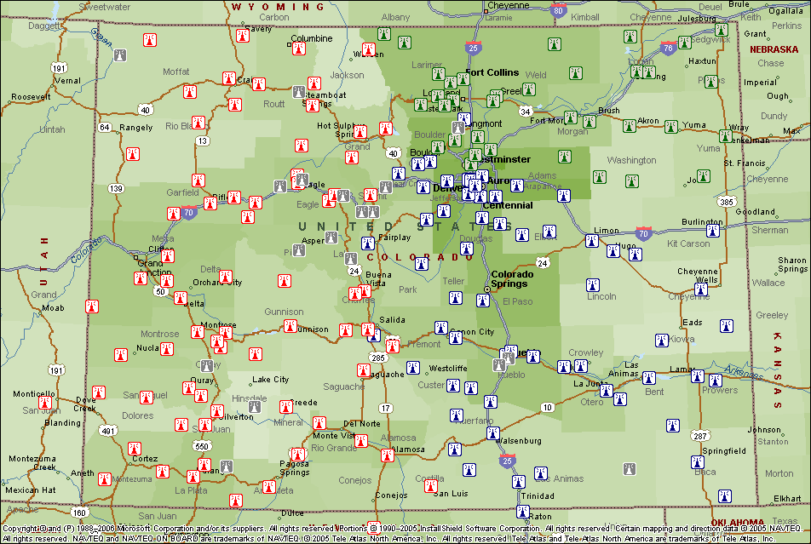
Colorado Site Map – September 2008
(www.ccncinc.org)
The Colorado Statewide Digital Trunked Radio System (DTRS) is a standards based digital trunked radio system consisting of over 160 sites and three zone controllers. Upon build out the system will exceed 180 sites.
Blue | Zone 1
Red | Zone 2
Green | Zone 3
Gray | Future Sites

Slide 9
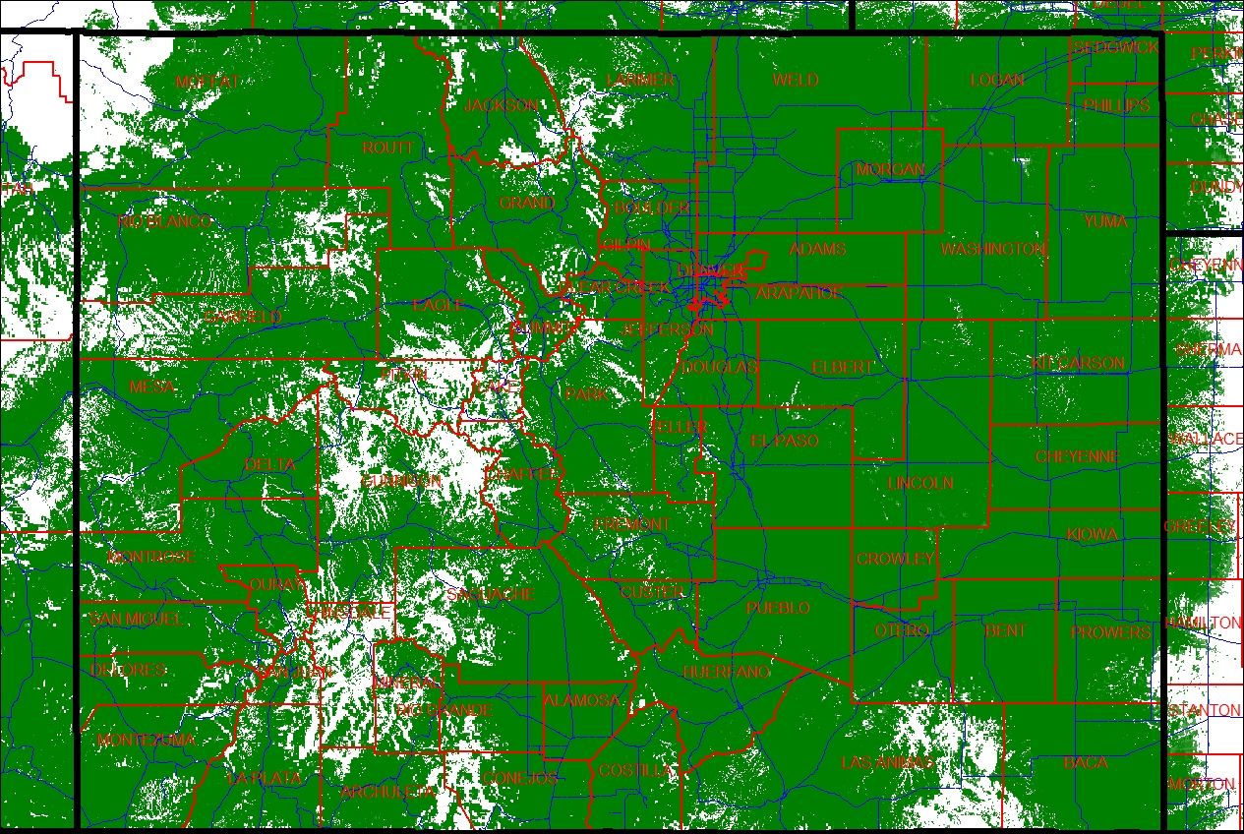
Existing Coverage Map

Slide 10
GRAND COUNTY CHANNEL TEMPLATE

Slide 11
Mutual Aid

Slide 12
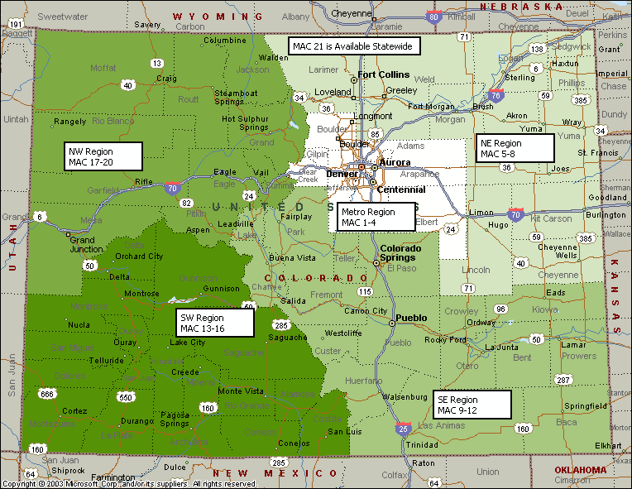
Mutual Aid Channels (MAC)
The State has been divided into 5 Mutual Aid Regions.
Each Region has 4 Mutual Aid Channels.
There is 1 statewide mutual aid channel.
Note:
Standard Operating Procedures are developed for use of these channels. Please refer to the SOP for additional specialized MAC channels.

Slide 13
Traveling Between Mutual Aid Regions
Agencies may have need to travel between mutual aid regions for various reasons.
When traveling between regions, agencies should change their radios to an agency defined talkgroup for traveling when leaving their normal operational area. This is due to system loading considerations. Consult with your Radio System Administrator/Coordinator for further information.
Agencies should not broadcast their dispatch channel (“dragging their channel”) around the state in areas where not designed for the additional talkgroup loading (CCNC SOP Sec. 7.4.9).
If an agency does not have a predetermined talkgroup for traveling, they should refer to Section 7.4.9 of the CCNC, Inc. SOP for channels that may be available for use.

Slide 14
TRAVELING OUTSIDE OF GRAND COUNTY REGARDLESS OF PURPOSE
USE GRAND MAC AS OUR TRAVEL CHANNEL
Zone A channel 8
and/or
Zone B channel 2

Slide 15
WHY?
If you travel out of county and you do not switch over
to GRAND MAC, you take the entire Grand County
800 Radio system and all of it’s current users with you
And tie up the State System in the area you are
traveling through

Slide 16
If you are assigned to respond outside of Grand County to Assist another Agency, what Channel do you use?
USE GRAND MAC FOR TRAVELING OUTSIDE OF COUNTY
AND
WHEN YOU REACH YOUR DESTINATION YOU WILL SWITCH OVER TO THE MUTUAL AID CHANNEL FOR THE INCIDENT THAT WAS PROVIDED TO YOU PRIOR TO THE ASSIGNMENT

Slide 17
Mutual Aid Channels (MAC)
Mutual Aid Channels are not designed for an individual agencies day-to-day operations.
They are designed for mutual aid events where there are no other available common channels or talkgroups for use by the responding agencies.
For further information concerning MAC, refer to:
CCNC, Inc. Standard Operating Procedures.

Slide 18
Additional Mutual Aid
As well as the MAC talkgroups, there are other talkgroups set aside for other specific uses. These include, but are not limited to:
    Public Safety Communications Center Talkgroups (Com-to-Com Nets)
    Regional Emergency Medical and Trauma Council (RETAC / EMS) Talkgroups
    County Health Department Talkgroups (CHD’s)
    Regional Interoperability Talkgroups (RIC’s)
    Statewide Simplex Channels (5 frequencies), STAC & STACD
    International Interoperability Channels (8CALL90 and 8TAC’s)
For further information concerning mutual aid talkgroups, refer to:
CCNC, Inc. Standard Operating Procedures and your Radio System Administrator/Coordinator.

Slide 19
Basic Radio System Information
( “Radio 101” )

Slide 20
“Radio 101”
The following slides explain some very basic radio systems and terms.
With the DTRS, one radio can have a combination of different radio systems.
Do not confuse systems with frequencies. They are different items.
  Frequencies (spectrum) are VHF, UHF, 700 MHz, 800 MHz, etc.
As always, check with your Radio System Administrator/Coordinator for information on your particular radio configuration.

Slide 21
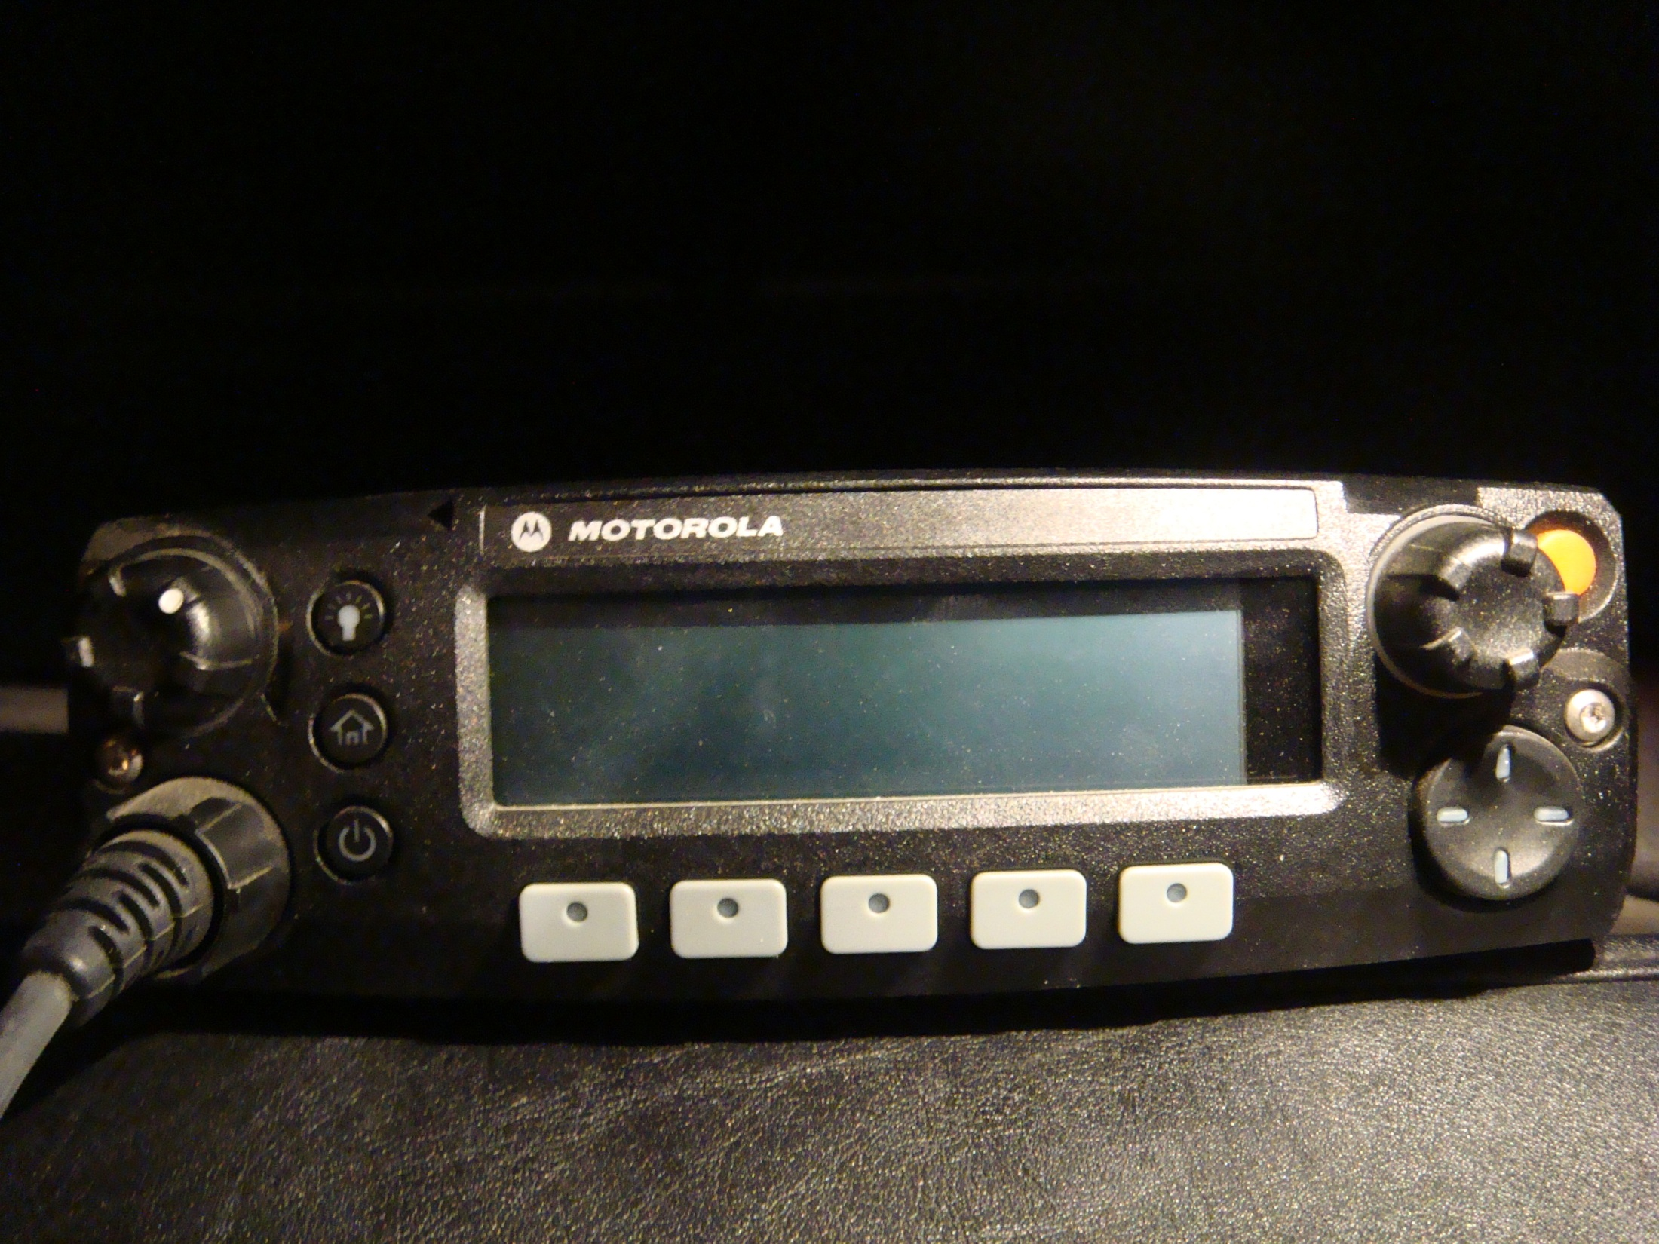

Slide 22


Slide 23
POWER BUTTON

Slide 24
HOME BUTTON
Push and hold for 2 seconds takes you to
Primary Channel-Grand Dispatch

Slide 25
Light illumination selector button; dim medium and bright

Slide 26
Volume Button

Slide 27
Channel Selector knob
DOES NOT CHANGE ZONES
Only changes channels within a zone

Slide 28
Changes illumination color, red, green or amber
Only when color button is depressed (see below)
Color button

Slide 29
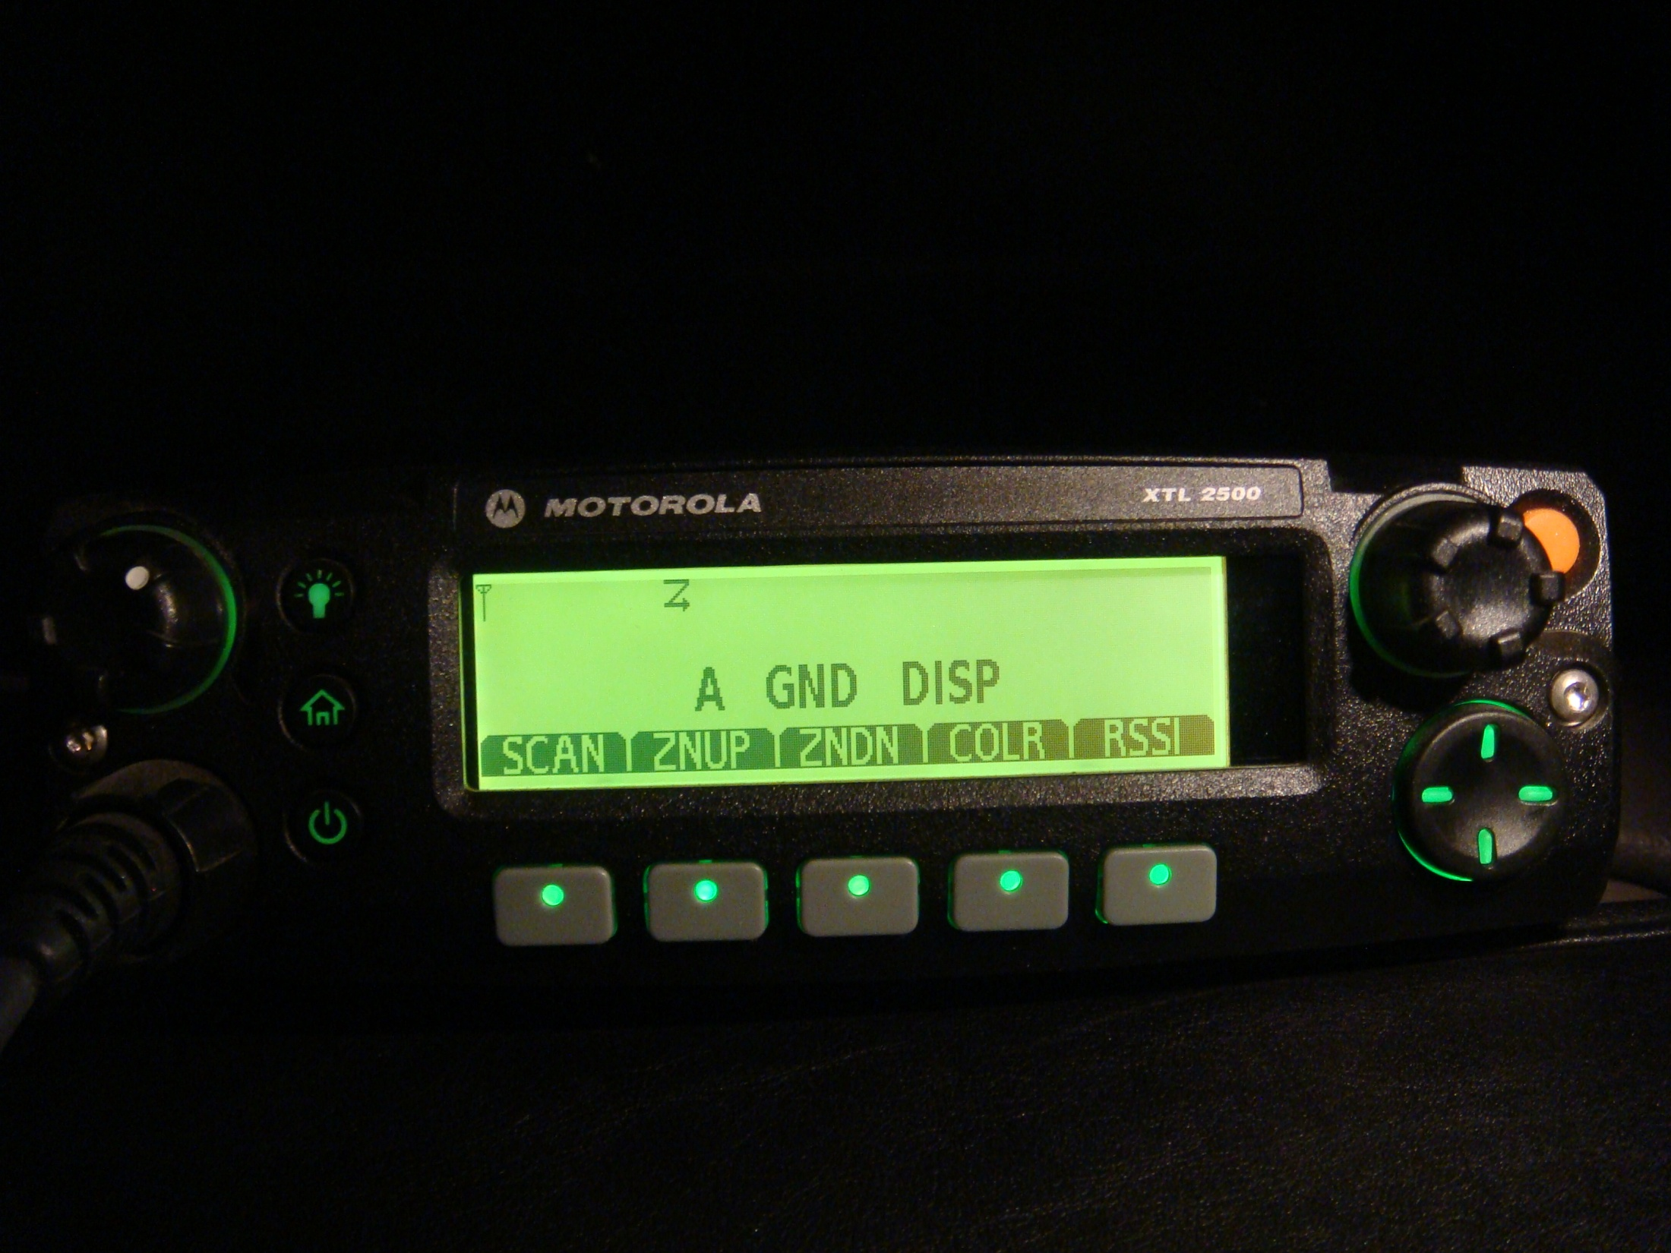

Slide 30
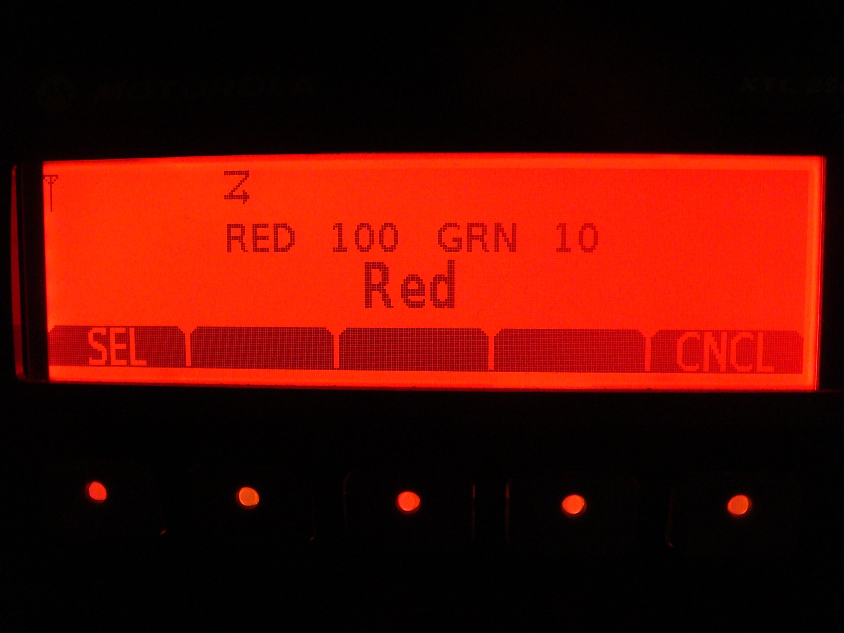

Slide 31
Changes illumination color, red, green or amber
Only when color button is depressed (see below)
IF YOU DON’T PUSH COLOR BUTTON FIRST…
ILLUMINATION COLOR WILL NOT CHANGE
Color button

Slide 32
SCAN BUTTON: You can only scan your primary channel
And the channel you have “selected”. It DOES NOT scan all
Channels in a zone!!!

Slide 33
ZONE UP BUTTON. Radio’s are programmed to start on
Zone A, channel 1. So if you need to change zones use this
button

Slide 34
ZONE DOWN BUTTON: Use this button to change Zones
down

Slide 35
COLOR BUTTON

Slide 36
RSSI BUTTON: Tells you what tower
You are hitting and signal strength

Slide 37
Trouble Alarm (Disabled)

Slide 38
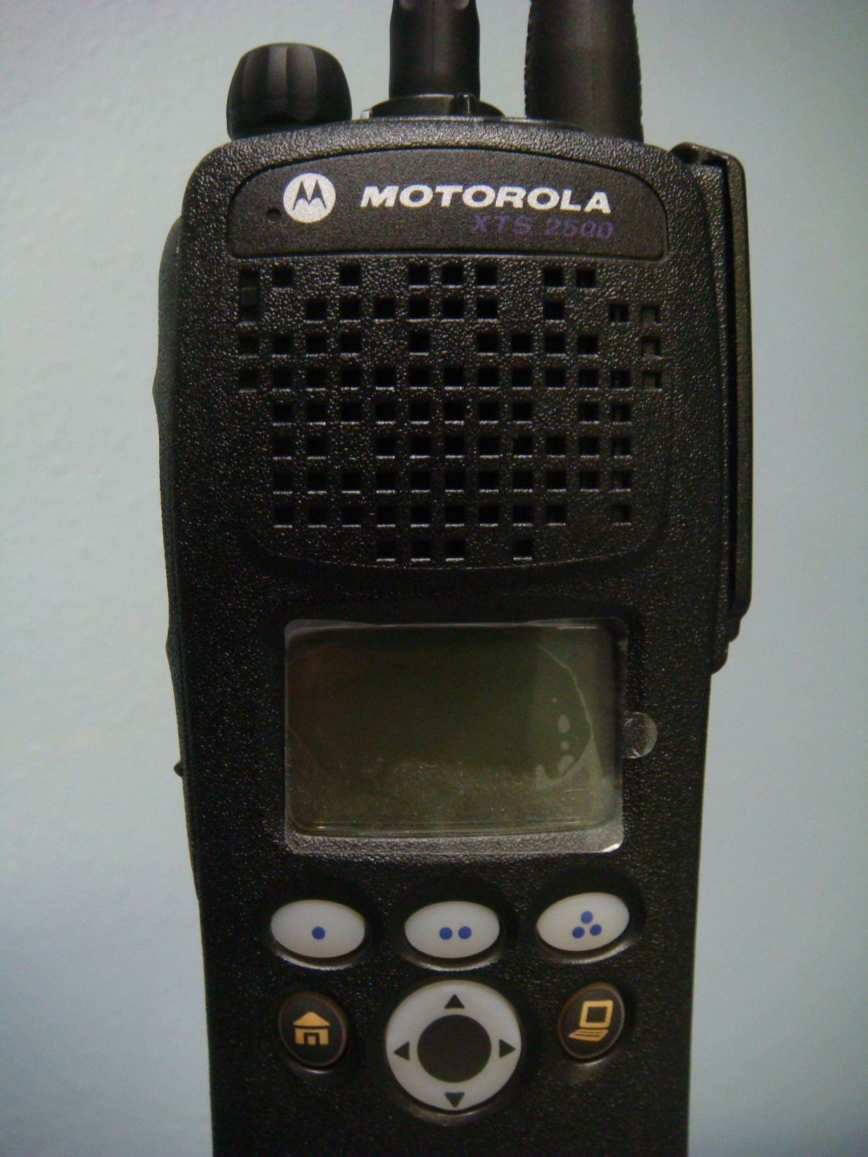

Slide 39
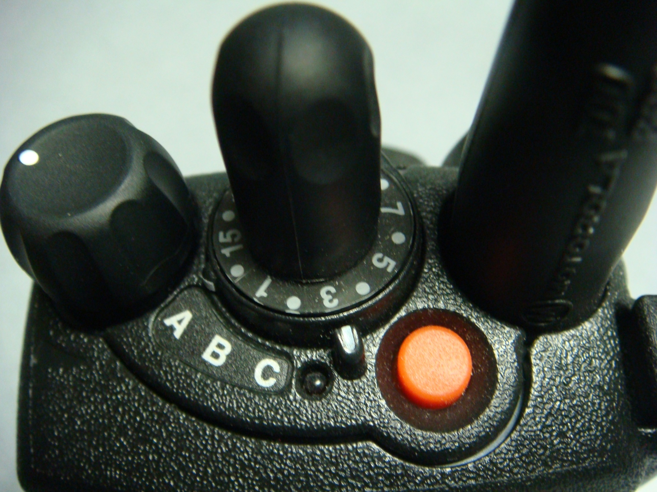
ON/OFF AND VOLUME SELECTOR KNOB

Slide 40
Channel Selector knob both Up and Down

Slide 41
NOT ENABLED in FIRE RADIOS
OIT BUTTON, “Officer In Trouble”
Push it and Alarms go off in Dispatch.

Slide 42
N/A
OIT BUTTON, and yes Tim, they know who
pushed the button

Slide 43
N/A
OIT BUTTON, to reset OIT push and depress for
5 seconds

Slide 44
Channel Indicator Mark

Slide 45
ZONE SELECTOR SWITCH
(behind channel selector knob)

Slide 46
SCAN ON/OFF
BUTTON

Slide 47
Zone Up
Selector Button

Slide 48
Zone Down
Selector button

Slide 49
HOME RETURN
Zone A, channel 1

Slide 50
Clock setting

Slide 51
UNKNOWN ACTION

Slide 52
UNKNOWN ACTION

Slide 53
Clock Setting

Slide 54
DISPLAY WINDOW

Slide 55
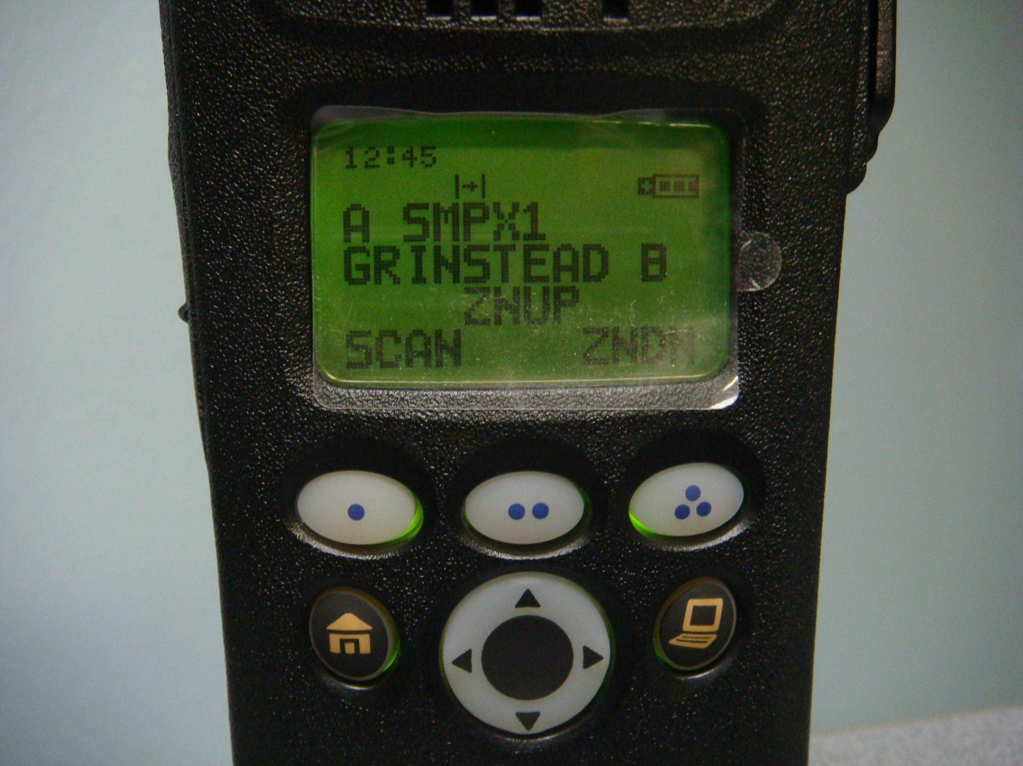
Talk Around Symbol-Antenna to Antenna
Selectable for certain TG
8Call90-8TAC91
8TAC92-93-94
Scan Indicator
1 DOT Button
Push to change
SCAN setting
Z indicates on

Slide 56
ZONE INDICATOR

Slide 57
CHANNEL INDICATOR

Slide 58
ZONE UP
2 DOT Button

Slide 59
ZONE DOWN
3 DOT Button

Slide 60
Battery Life
Indicator

Slide 61
Current time Setting
Does not matter
if it is inaccurate

Slide 62
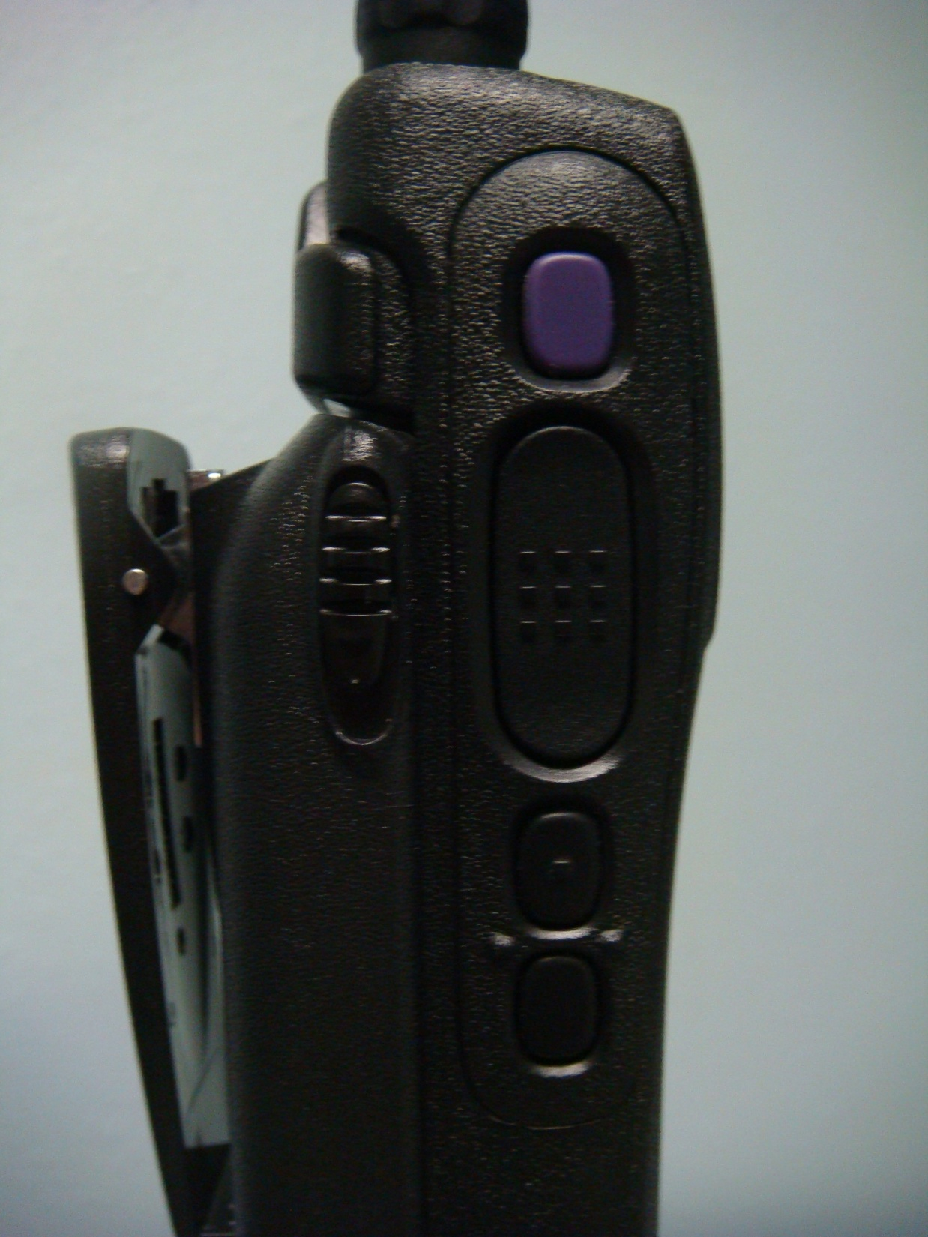
DISPLAY LIGHT
Button

Slide 63
Push to Talk
Button

Slide 64
Key Pad Lock button

Slide 65
RSSI Button:
Tower & Signal strength
ALSO used to switch
Between REPEATER and
TALKAROUND on
8CALL90 8TAC91-92-93
and other
SELECTABLE SIMPLEX/
Repeater TG’s

Slide 66
Battery Release Button
One of Two

Slide 67
REPLACEMENT COSTS
Pak Sets $2,500.00
Mobile Radio’s $3,000.00

Slide 68
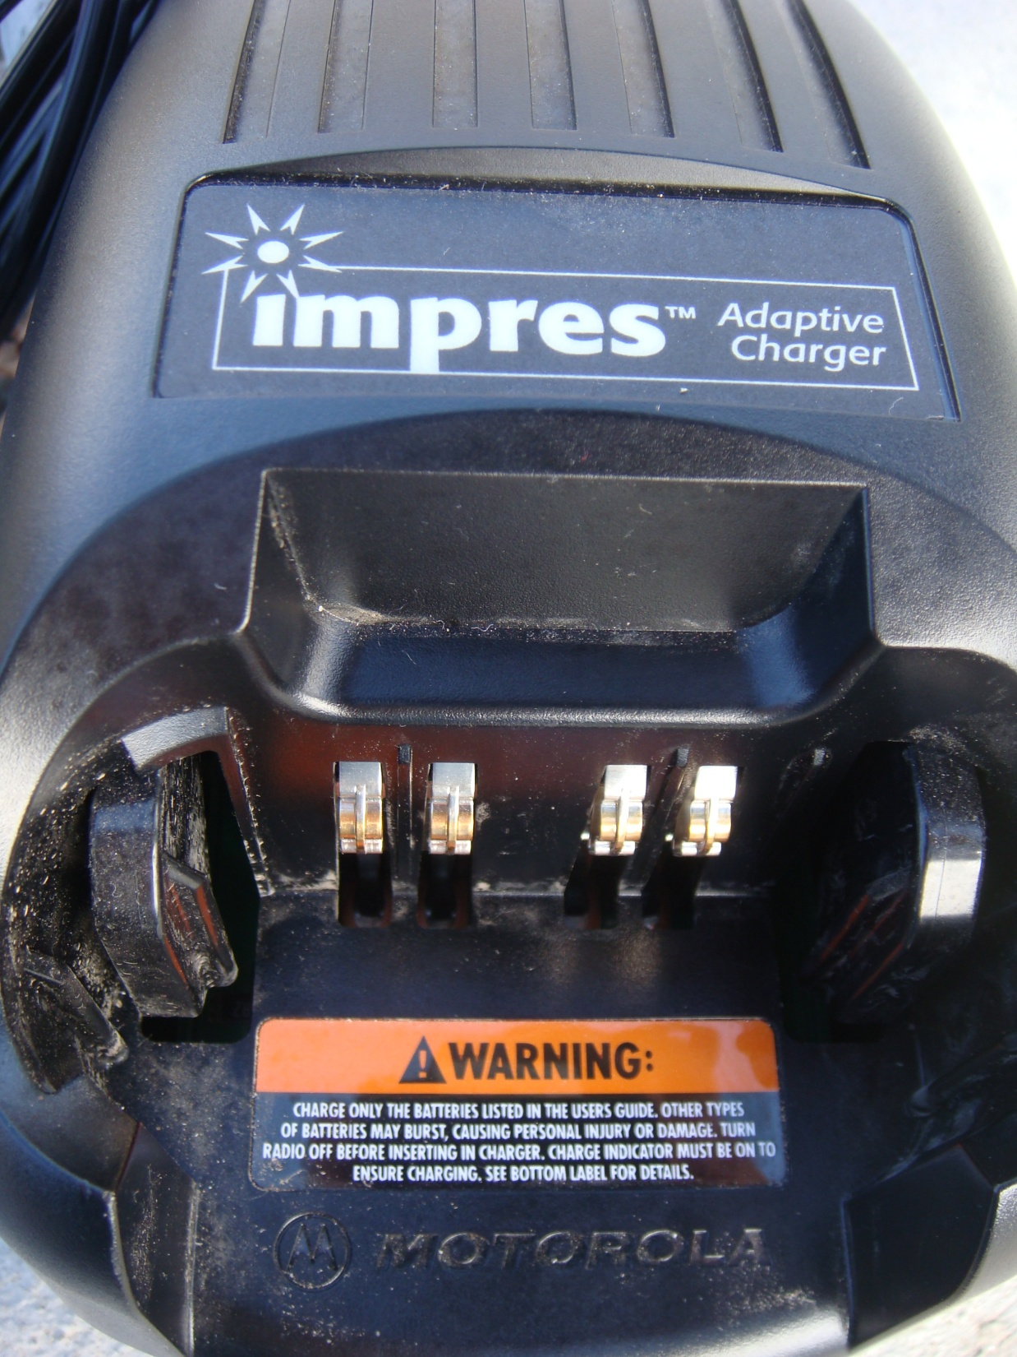

Slide 69
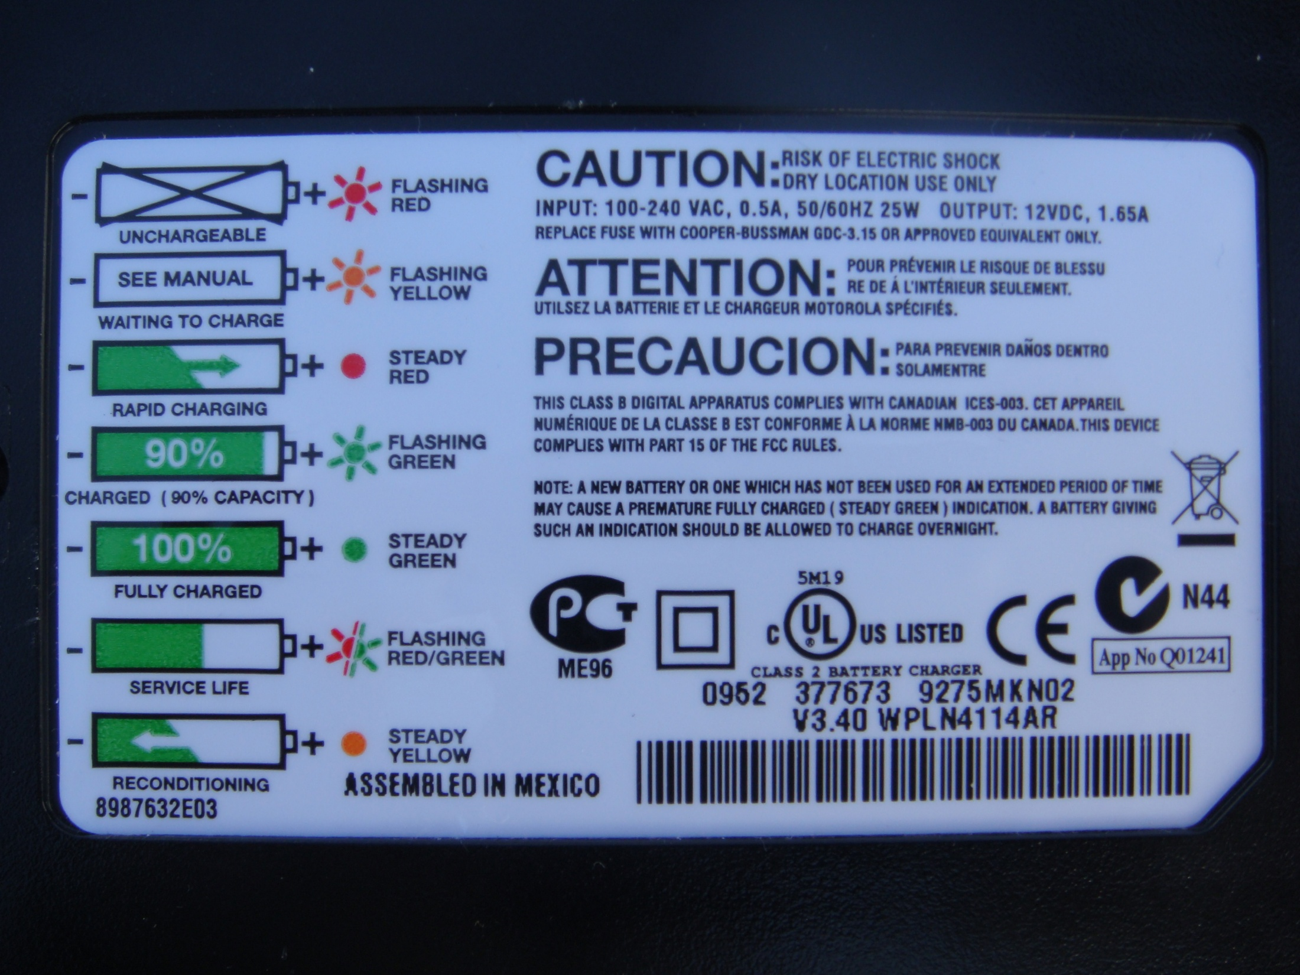

Slide 70
BATTERY CHARGING
This is a “smart battery” and it has the ability to
Recondition itself.
The next slide shows you what the light indicator
on your charger means to its operation.
LET THE BATTERY RECHARGE
COMPLETELY BEFORE REMOVING
If you need to charge (no spare) insert-
remove then reinsert to quick charge

Slide 71
Systems
Types of Systems
  Radio-to-Radio
  Conventional Repeater System
  Single Site Trunked System
  DTRS (Multi-Site) System

Slide 72
Radio-to-Radio
(Non-Repeated) System
Common Terms
Simplex
Talk-around
Direct
Fireground
Unit-to-Unit
This communication does not go through an antenna site with a repeater.
Conventional Operation –
Analog or Digital

Slide 73
Conventional Repeater System
Common Terms
Repeater
Duplex
Mobile Relay
Conventional Operation –
Analog and Digital
Single Antenna Site

Slide 74
Conventional Operation
Police
Fire
EMS
Admin
Other
Similar to a grocery store line
Users assigned to one channel/repeater/antenna site.

Slide 75
Single Site Trunked System
Antenna site with various number of repeaters.
Controller
Control Channel
  Listens for data sent from radio
    System Name
    Unit ID
    Talkgroup

Slide 76
Single Site Trunked System
Trunked Operation: Analog and Digital
Antenna Site
Channel (Repeater) | Channel (Repeater) | Channel (Repeater) | Channel (Repeater) | Control Channel
System Name
Unit ID
Talkgroup
Controller
Controller assigns transmission to next available open channel (repeater).

Slide 77
Basic Trunking Operations
Example 1:
Similar to a bank teller line.
You need banking services any teller can provide. The person at the front of the line is helped by the next available teller.
Example 2:
Similar to a cordless phone.
Your cordless phone can use different channels to complete your call but scans for the first open (unused) channel before connecting the call.
Similar to a bank teller line

Slide 78
Bank Teller Line

Slide 79
DTRS (Multi-Site) System
Multiple Trunked Sites Linked Together Through a Zone Controller.
Zone Controller

Slide 80
Colorado Statewide DTR System
Zone Controller
Zone Controller
Currently, 3 Zones are active in Colorado.
Zone Controller

Slide 81
Scanning Other Talkgroups

Slide 82
Scanning
Scanning of other talkgroups, though not prohibited, is discouraged because:
  It does not guarantee communications.
  Users may miss communications on their primary talkgroup as well as on the talkgroups that are being scanned.
The following slides give a brief overview of scanning.

Slide 83
Scanning
Basics 1 of 2
A Radio Needs To Be Affiliated With a Site In Order To “Draw The Audio Over” In Scan Mode.
In this example no one is using / has selected talkgroup ‘Agency -2’ on the ‘Site 1’ Site so the zone controller will not send ‘Agency -2’ audio to the ‘Site 1’ Site.
Agency-1 radios which are trying to scan Agency –2 will not hear any audio.
Site 1
Site 2
Zone Controller
Agency - 2
Agency - 2
Agency -1
Agency -1

Slide 84
Scanning
Basics 2 of 2
A Radio Needs To Be Affiliated With a Site In Order To Draw The Audio Over In Scan Mode.
In this example someone is using / has selected talkgroup ‘Agency - 2’ on the ‘Site 1’ Site. so the zone controller will send ‘Agency - 2 audio to both sites.
Agency -1 radios which are trying to scan Agency - 2 will now hear Agency - 2 audio.
Site 1
Site 2
Zone Controller
Agency – 2
Agency – 2
Agency -1
Agency – 2

Slide 85
Status Alert Tones

Slide 86

Status Alert Tones
With the DTRS, radios will “talk” to you. Here are some of the more common types of tones.
Keep in mind that these particular sounds vary by manufacturer and may or may not be heard based upon your programming configuration. Be sure to consult your manufacturer and Radio System Administrator/Coordinator.
Tone Name |  | Tone Information
Call Alert |  | Receipt of a Call Alert page sent to your radio by Dispatch
Emergency |  | Emergency tones heard in an assigned dispatch center when the orange button is pushed on the radio.
Failsoft |  | Radio has lost communication with the systems controller
Low Battery |  | Weak battery indication
Out of Range |  | Radio is out of range of the system
Power-up |  | Radio has successfully powered on
Prohibit |  | Talkgroup or channel is not accessible or authorized
System Busy |  | Talkgroup/Channel or System is busy
Talk Permit |  | Talkgroup / Channel is ready to use
Time-out Timer |  | Time-out timer limit has been reached
Notes:
Pressing each speaker symbol will play the sound heard from the radio
Not all sounds can be demonstrated live, for example Failsoft or system busy.

Slide 87
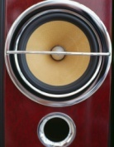
Emergency Button

Slide 88
Emergency Button
The emergency button may or may not be programmed into the radio to send an emergency signal to a designated dispatch center over a designated talkgroup.
The emergency button when activated, moves you to the front of the line and assigns the next available channel and may change your talkgroup based upon the programming.
There are several ways to program this feature into the radio. Consult with your Radio System Administrator / Coordinator for your particular configuration.
EMERGENCY BUTTON ACTIVATION

Slide 89
Emergency Button
Key Points to Remember
  Only some dispatch consoles have been designed to receive radio identifiers and aliases upon activation of an emergency button.
  If your dispatch consoles can not receive the radio identifier and alias, it is recommended that you make arrangements with a dispatch center that has the ability to monitor and manage activations of the emergency button.
  Please contact your Radio Administrator/Coordinator for questions regarding your agency configuration.

Slide 90
Emergency Button
Key Points to Remember
  Should a user activate the emergency button, remember to “clear” the emergency at the conclusion of the activation.
    For information on clearing the activation, refer to your radio manufacturers operational / programming information.
  An activation takes priority on the talkgroup (channel) as well as on the antenna site. It ties up resources until the activation is cleared.

Slide 91
System Busy

Slide 92
System Busy
This is an indication that the channel or system is busy and can not accept radio traffic.
  All of the channels at a site are handling radio traffic.
    Similar to the bank teller line where all of the tellers are busy with customers.
This occurs mostly when too many radio units are attempting to access the resources (channels) on an antenna site.

Slide 93
System Busy
System busy eliminates the days of talking over each other as was the case in older analog transmissions.
The system is designed, that should you receive a system busy, you are placed into a queue for the next available channel. Do not continue to hold down or re-key the push to talk (PTT) button.

Slide 94
System Busy
Once a channel becomes available, the system will notify the user with a talk permit tone.
Once the talk permit tone is received, the user can then transmit.
  There is a window of opportunity that the channel will be available for the user. If there is no transmission during that window of opportunity, the next user in queue then has access to the available channel.

Slide 95
System Busy
If a system busy tone is received and the user continually presses the PTT button, they will be placed lower in the queue for the next available channel.
  Like getting out of the bank teller line once you are at the front of the line.

Slide 96
System Busy
Ways to help reduce system busies:
  Keep transmissions short and concise.
    Do not use the system for non-essential transmissions.
  Clear emergency activations as soon as practical.
  Use a designated travel talkgroup when traveling between regions.
  Always be aware that other agencies are also using the same resources that you are using.

Slide 97
Out of Range

Slide 98
Out-of-Range
If you go out of the range of the system and can no longer lock onto a control channel:
You will not have trunked radio communications (simplex channels may be used based upon local policies).
Your radio remains in this out-of-range condition until it locks onto a control channel, or it is turned off.
This condition may be represented by a tone and/or a display on the radio. Consult with your Radio System Administrator/Coordinator.

Slide 99
Site Trunking
Site Trunk

Slide 100
Site Trunking
In the DTRS system, if a particular site loses connectivity to the zone controller, the site enters into a site trunking operational mode.
In this mode of operation, the user can only communicate with other units using the same site.
This could also isolate the user from their communications center if both the user and the center are not using the same site.
Radios in the DTRS system can be programmed by a qualified radio technician to indicate when site trunking becomes active.
Any questions contact your Radio System Administrator/Coordinator.

Slide 101
Additional Information
Radio Specific Information
Contact Your Radio System Administrator/Coordinator
CCNC, Inc. Standard Operating Procedures
www.ccncinc.org/
DTRS System Information
Visit our website at www.ccncinc.org/
Visit Colorado’s website at www.colorado.gov/oit
Meeting Information
www.ccncinc.org/

Slide 102
Thank You!
Thank You For Your Interest and Participation

